Slide 1


Slide 2

DOM

Slide 3
Dom Introduction
JavaScript is mostly used to provide a means for our visitors to interact with our web page.
In order to be able to do this we need to have some means by which our JavaScript program can access the component parts of the web page.
This is done using DOM ( Document Object Model)

Slide 4
What Is DOM ?
When a Web browser loads an HTML file, it displays the contents of that file on the screen.
But that’s not all the Web browser does with the tags, attributes, and contents of the file: it also creates and memorizes a “model” of that page’s HTML.
In other words, the Web browser remembers the HTML tags, their attributes, and the order in which they appear in the file—this representation of the page is called the Document Object Model, or DOM in short

Slide 5
Example(Human View)
<html>
<head>
<title>An Example XHTML Document</title>
<link rel="stylesheet" href="style.css" type="text/css" />
</head>
<body>
<p>This is an example paragraph.</p>
<p>This is an example paragraph with
<a href="stuff.html">a hyperlink</a> inside of it!</p>
<p>And here's one with<br />a line break
and an <img src="image.jpg" alt="image">.</p>
</body>
</html>

Slide 6
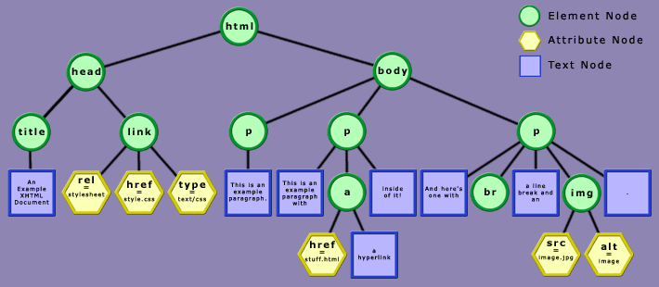
Browser View

Slide 7
Explanation
In the HTML DOM, everything is a node.
The entire document is a document node
Every HTML element is an element node
The text inside HTML elements are text nodes
Every HTML attribute is an attribute node

Slide 8
What Can Be Done With DOM ?
With DOM , a programmer gets all the power he needs to create dynamic HTML:
Using DOM we can can change all the HTML elements in the page
Using DOM we can can change all the HTML attributes in the page
Using DOM we can can change all the CSS styles in the page
Using DOM we can can react to all the events in the page

Slide 9
DOM Properties
1. childNodes
Returns an array of all the children of the specified node.
2. firstChild
Returns the first child node
3. lastChild
Returns the last child node

Slide 10
DOM Properties
4. nextSibling
Returns the node immediately following the specified node.
5. previousSibling
Returns the node immediately preceding the specified node.
6. parentNode
Returns the parent node of the specified node

Slide 11
DOM Properties
7. nodeName
Returns the name of the node. If the node is an element it returns the tag name of the node and if the node is a text it returns“#text”.
8. nodeValue
Returns the value of the node . If it is text node then the actual text is returned and if it is an element then null is returned.
9. innerHTML
Sets or retrieves the HTML between the start and end tags of the object.

Slide 12
DOM Properties DrawBacks
Although we can select html elements using DOM properties but this approach is very difficult to maintain because:
a. Any change in the page’s HTML code would require to change our DOM coding
b. Many properties have different behaviors in different browsers.
Thus a better approach is to use DOM selection methods

Slide 13
DOM Selection Methods
Selection of elements can be done by 3 methods:
getElementById( idvalue)
This method selects and returns only that element whose id value matches with the string passed as argument.
Example:
var x=document.getElementById(“p1”);

Slide 14
DOM Selection Methods
getElementsByTagName( tag name)
This method selects and returns an array of those HTML elements whose tag matches with the string passed as argument.
Example:
var x; x=document.getElementsByTagName(“p”);

Slide 15
DOM Selection Methods
getElementsByClassName( class name)
This method selects and returns an array of those HTML elements whose class name matches with the string passed as argument.
Example:
var x; x=document.getElementsByClassName(“cl”);

Slide 16
Setting/Getting Text Node Value
To set/get a text node’s value we can use the following approach:
1. Obtain reference to it’s parent node
2. Access the text node by using “firstChild” or “childNodes[0]”
3. Finally set/get it’s contents using “nodeValue”

Slide 17
DOM Modification Methods
Changing HTML content
Changing CSS styles
Creating new HTML elements
Removing existent HTML elements

Slide 18
Changing HTML
To change an elements HTML content we need to do the following:
1. Obtain a reference to the element.
2. Use it’s innerHTML property to change it’s HTML effect

Slide 19
Changing CSS
To change an elements CSS style we need to do the following:
Obtain a reference to the element.
Use it’s style property to gain access to it’s CSS coding.
style property itself has child properties for specific styles. Like:
backgroundColor
color
borderColor
fontFamily
fontWeight : bold,bolder,lighter,normal,100to 900
fontStyle: normal,italic,oblique

Slide 20
PROGRAM
In the code shown below write the body of the function showDate( ) so that it displays current system date in the para p1 whenever the button is clicked.

Slide 21
PROGRAM
In the code shown below write the body of the function decorate( ) so that all the elements with the class value highlight get a red color solid border of 1 px.

Slide 22
Creating New Element
To create new HTML elements we use 3 steps:
1. Create a new element with createElement( ) , passing it the name of tag as a string argument.
Create a new text node using createTextNode() method passing it the text to be added as a string argument.
Add the text node to the element node by calling the method appendChild() on element node object and passing text node object as argument.
Add the element node to it’s container using appendChild( ) method.

Slide 23
PROGRAM
In the code shown below write the body of the function addPara() so that it generates a new para with the text “This is para 3” whenever the button is clicked.

Slide 24
PROGRAM
Now rewrite the code so that the function addPara() generates a new para with the text “This is para <para no>” where para no should be replace with para number 3 ,4 ,5 and so on whenever the button is clicked.

Slide 25
PROGRAM
Create an HTML page which on loading displays a button . As soon as the button is clicked there should appear an unordered list containing names of programming languages.

Slide 26
PROGRAM
Create an HTML page which shows a button and when the user clicks it , the page should display a digital clock.

Slide 27
Using insertBefore()
The appendChild( ) method always adds the element at last of the parent element.
In case we want to set it in mid or on top we need to call the method insertBefore( )
It takes 2 arguments:
1. New element to be added.
2. Element before which it is to be added.

Slide 28
PROGRAM
Rewrite the code so that the function addPara() generates a new para with the text “This is new para” before the first para

Slide 29
PROGRAM
Create an HTML page which contains a list with 2 elements RED and BLUE and a button titled add color. The moment user clicks it the code should ask for a new element and an existing element. Then it should add the new element after the given existing element.

Slide 30
Using setAttribute() Method
DOM provides us a method called setAttribute() using which we can set the HTML attributes of any HTML element
The method has following syntax:
<dom_element>.setAttribute(“<html attrib”>,”<value>”)

Slide 31
Removing Elements
To remove an elements we use 3 steps:
1. Obtain a reference to the parent element of the element to remove.
2. Obtain a reference to the child element to remove.
3. Call the method removeChild( ) on parent element passing it child element to remove.

